Slide 1
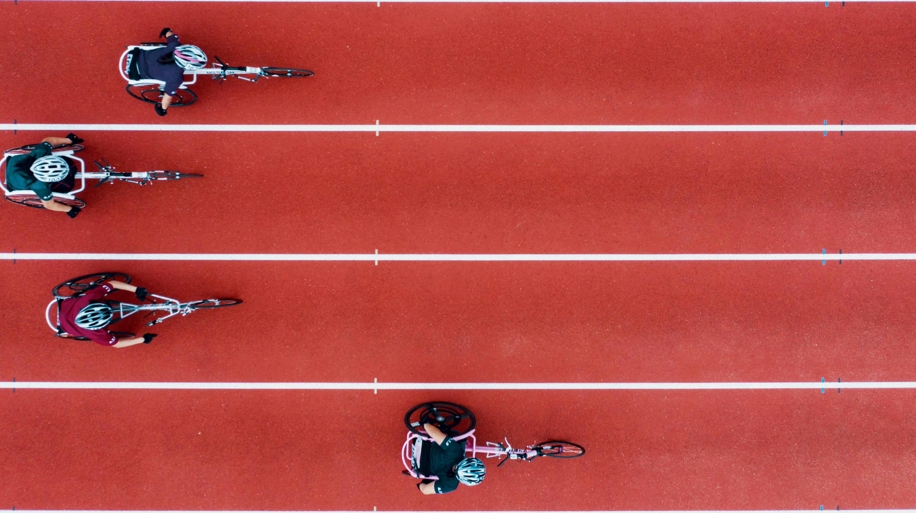
From Athens to Beijing
Visualizing the World’s Greatest Athletes

Slide 2


The Data Olympians
Vedrana Basimamovic
Stephen Jackson
Hee Oh
Bob Pickerel
Andres Almarez
Leon Lee
Gary Groscost
Brian Hall
Michael Damas
Vinika Patel
Colleen Kearns

Slide 3
Project Proposal

Slide 4
Project Goals

Slide 5
Target Audience
Casual and diehard Olympic fans
Teams looking to scout other competitors
Cities looking to become potential hosts
The International Olympic Committee

